Slide 1
Nucleotides and Nucleic Acids
Dr. Shiromi Perera

Slide 2
Basics
  Building Blocks
  Canonical and Minor Bases
  Phosphodiester bonds
  Naming and Drawing
  Base Stacking and Pairing

Slide 3
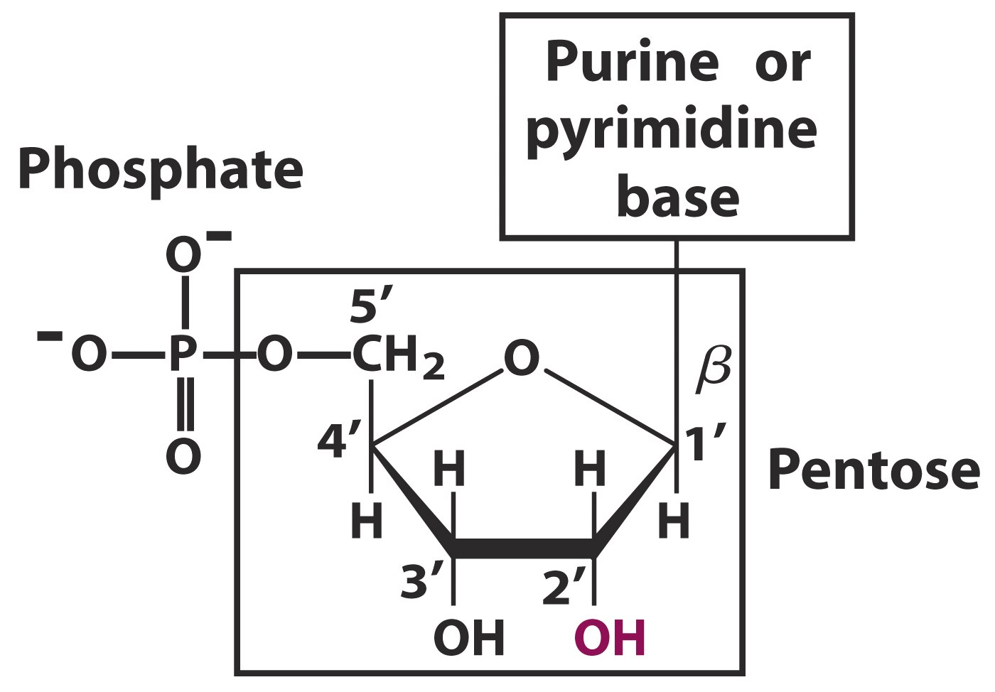
Building Blocks
  Nucleotides = Base + Sugar + Phosphate
  Nucleosides = Base + Sugar

Slide 4
  Nitrogen Bases
  Purines (5 + 6 membered rings) - Adenine, Guanine
  Pyrimidines (6 membered ring) - Thymine, Cytosine, Uracil
  Pentose Sugars (numbering)
    Ribose
    Deoxy Ribose

Slide 5
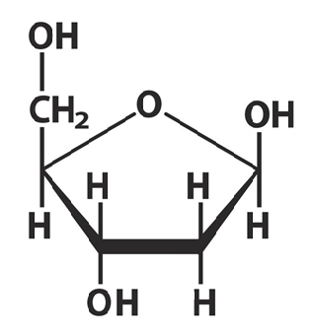
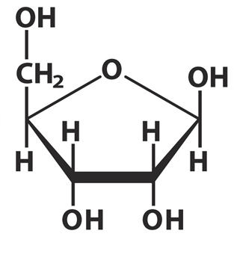
Deoxy Ribose sugars
Pentose sugars
Ribose sugars

Slide 6
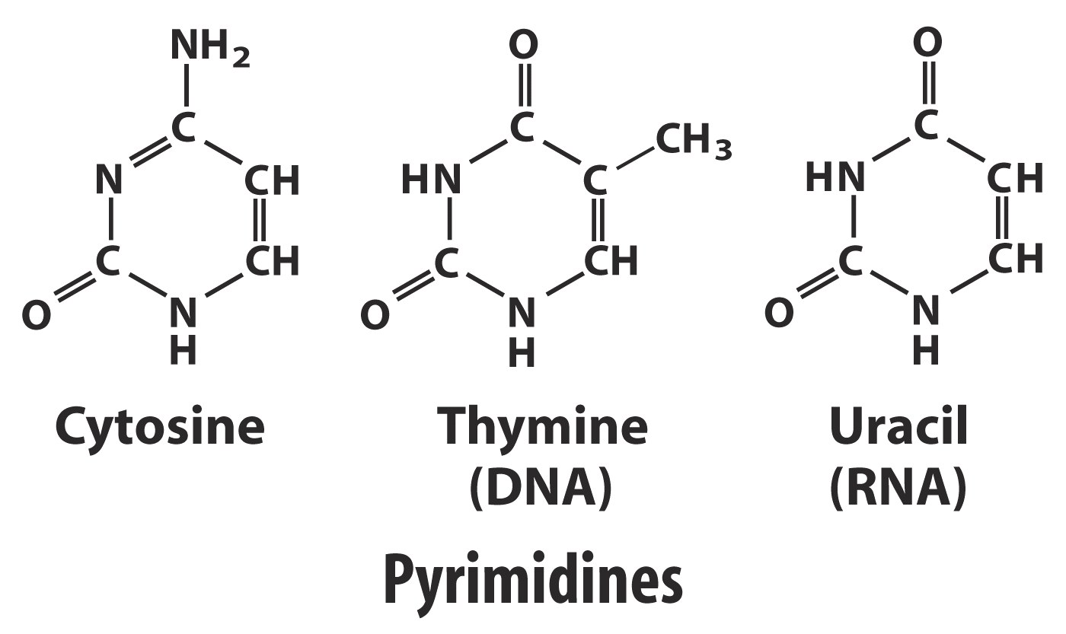
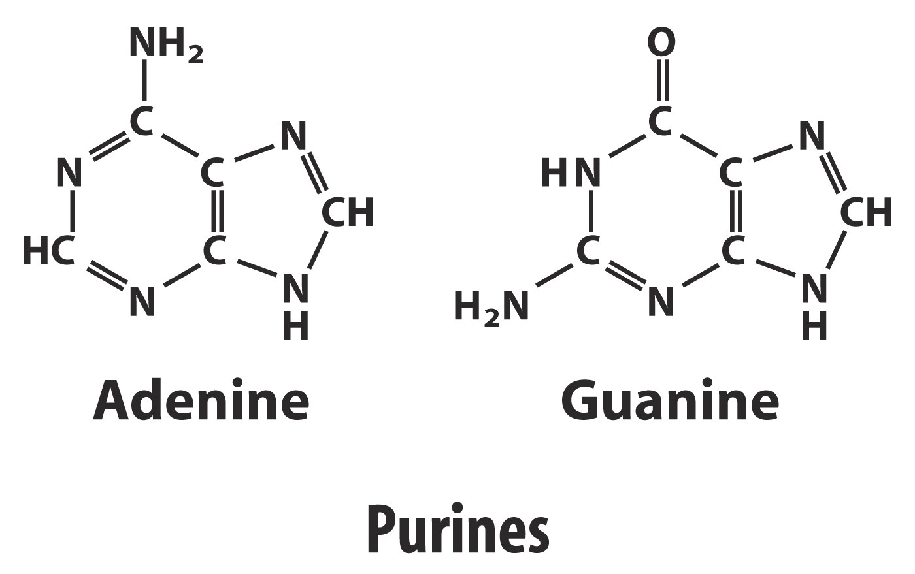
Canonical Bases
  DNA - A, G, C, T
  RNA - A, G, C, U

Slide 7
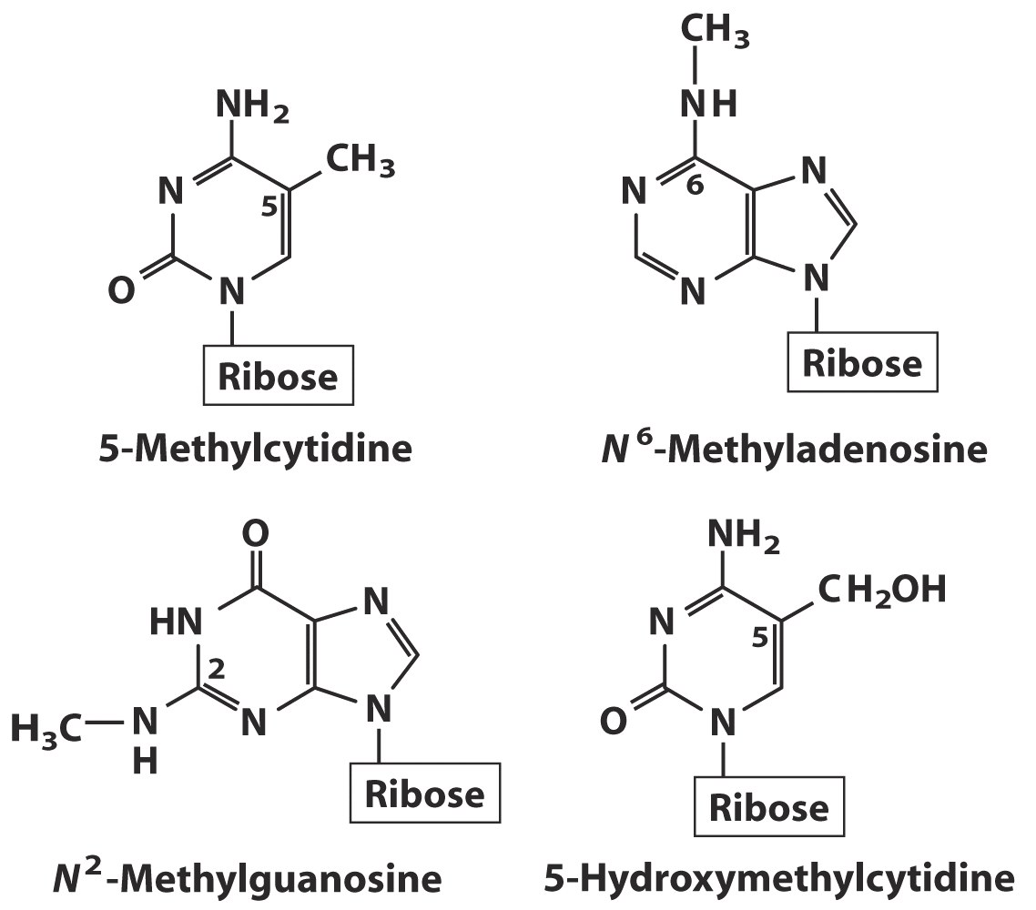
Modified Bases
  Methylation in DNA

Slide 8
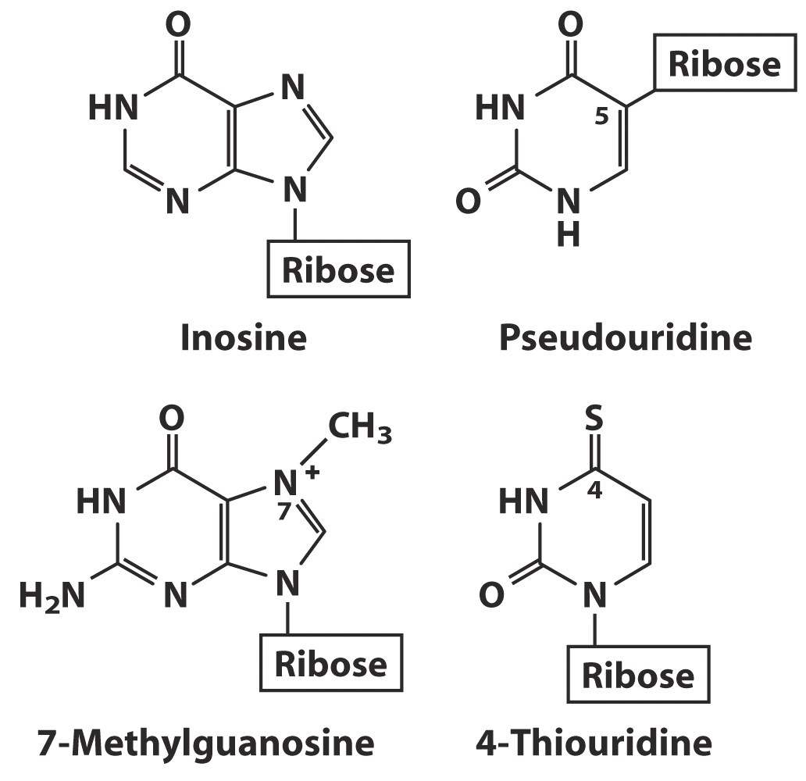

Slide 9
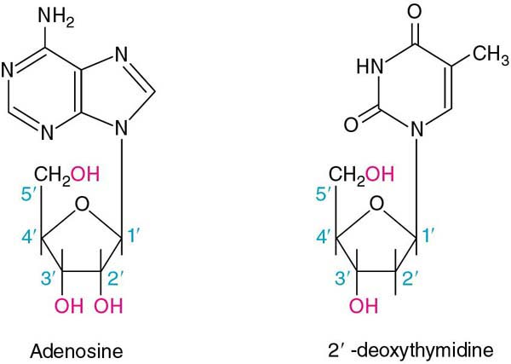
Nucleoside
BOND

Slide 10
Arrangement of Bases
Base
Nucleoside
Deoxynucleoside
adenine
adenosine
deoxyadenosine
guanine
guanosine
deoxyguanosine
cytosine
cytidine
deoxycytidine
uracil
uridine
(not found in DNA)
thymidine
(not found in RNA)
(deoxy)thymidine*

Slide 11
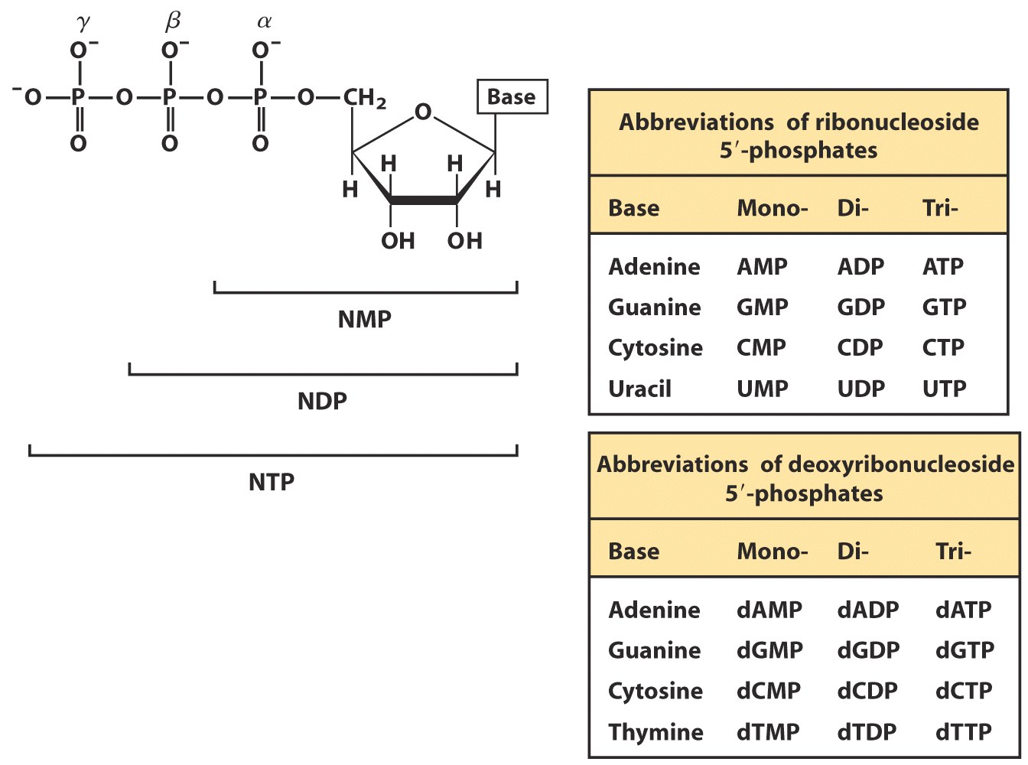
Nucleotides

Slide 12
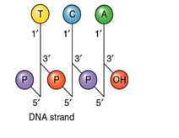
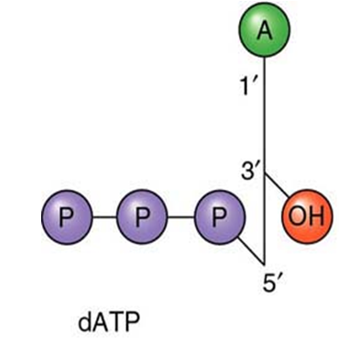
Primary structure of Nucleic acid
In the primary structure of nucleic acids
nucleotides are joined by phosphodiester bonds.
the 3’-OH group of the sugar in one nucleotide forms an ester bond to the phosphate group on the 5’-carbon of the sugar of the next nucleotide.

Slide 13
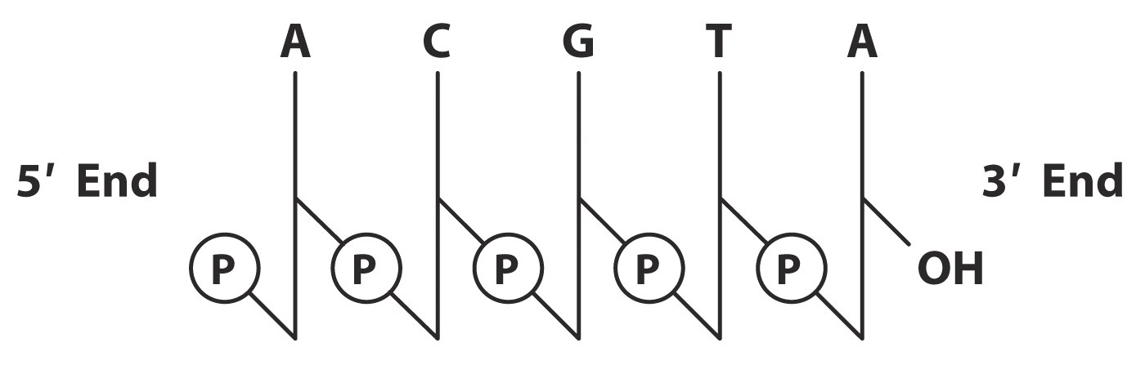
Oligonucleotide naming / drawing conventions
  5’ - Left to Right - 3’
  pACGT_{OH}
  ACGT

Slide 14
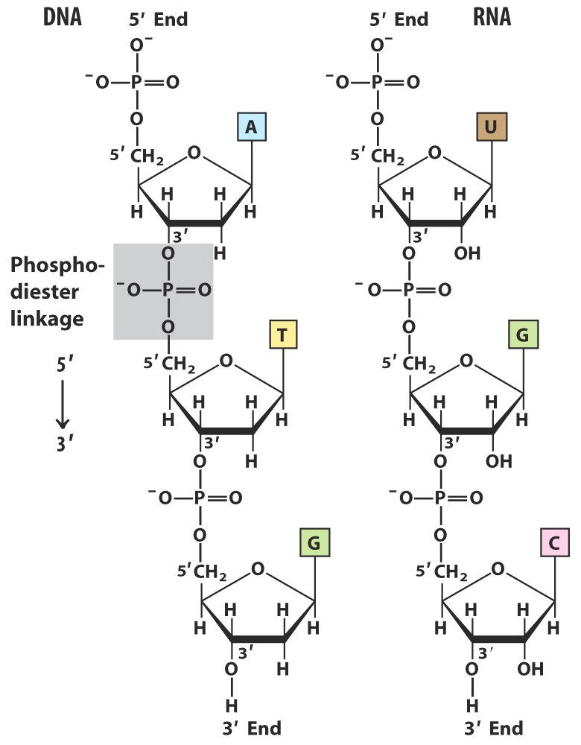
A nucleic acid has a free 5’-phosphate group at one end and a free 3’-OH group at the other end.

Slide 15
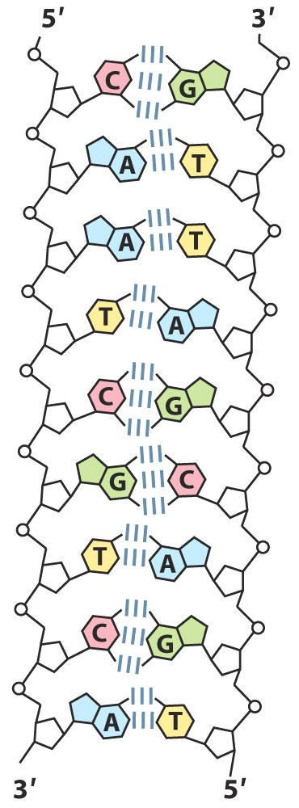
DNA structure
  Deoxy ribose sugar
  A,G,T,C bases
  James D. Watson and Francis H. C. Crick proposed a structure for DNA in 1953.
  Double helix structure
  Two anti parallel DNA strands
Back bone - Sugar phosphate
Interior – stacks of bases

Slide 16
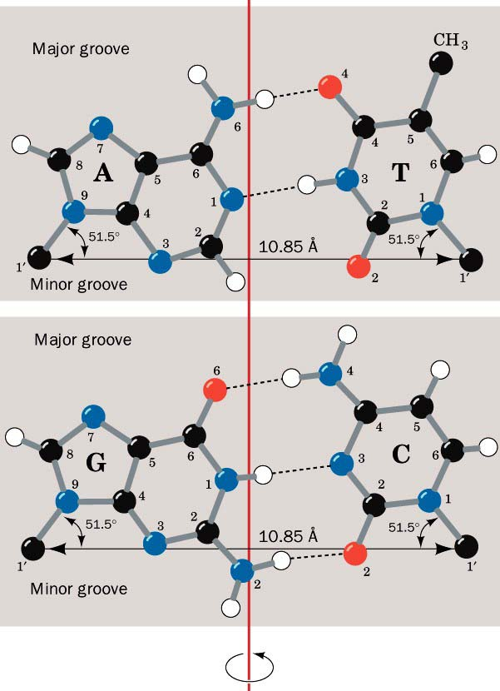
DNA Double strand
G
C
A
T
Two strands are antipararel and complimentary.
Purines are equal to pyrimidine in number

Slide 17
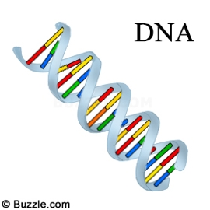
Double helical structures
  Mostly Right Handed
  Anti-parallel
  Contains major and minor grooves
  Sugar Pucker + 6 rotatable bonds gives 3 families
  A, B, Z structures
  These three families are basically determined by the arrangement of secondary structure.

Slide 18
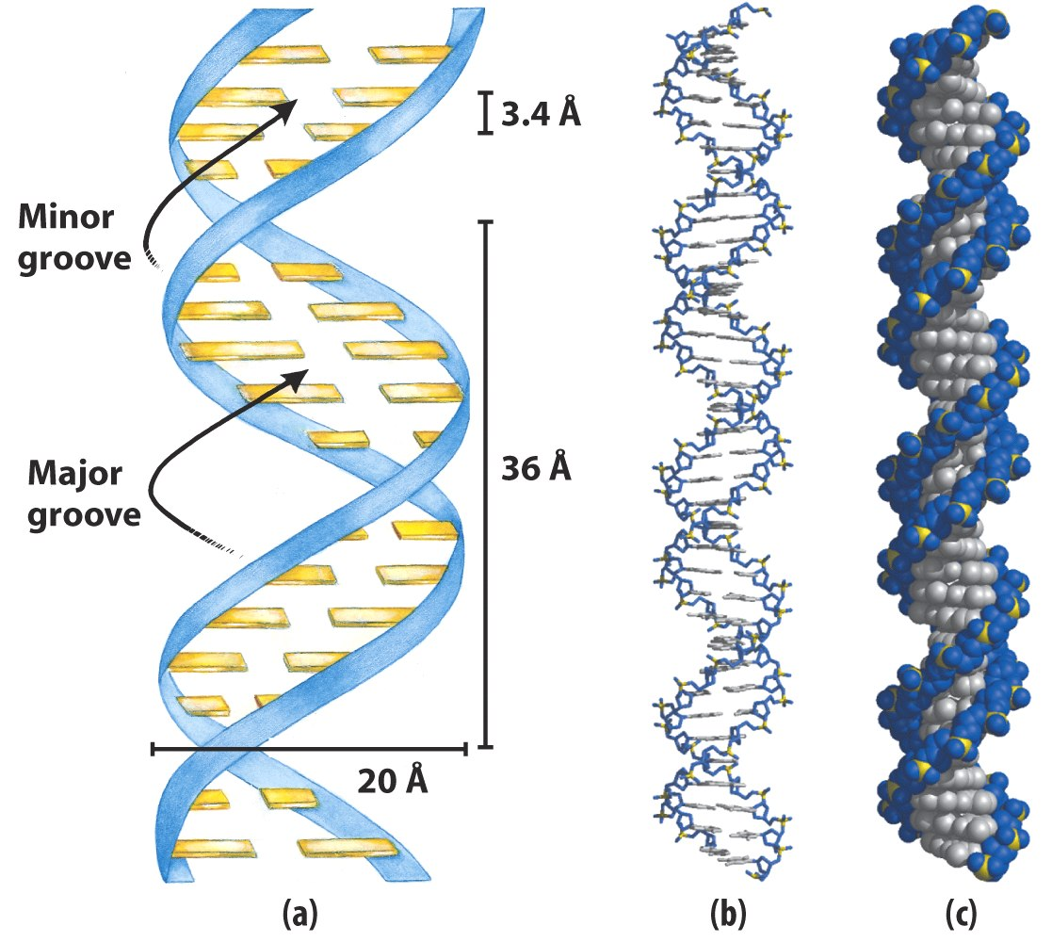
B-DNA
Helical structure - Non covalent bonds important
  H-bonds
  (base-pairing)
  Base stacking

Slide 19
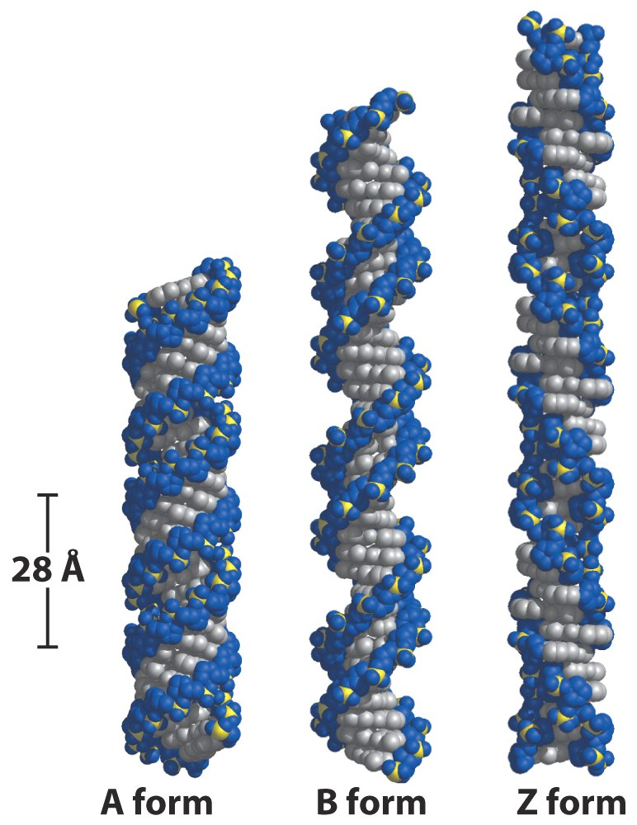
A, B and Z DNA
B form – Standard DNA double helix under physiological conditions

Slide 20
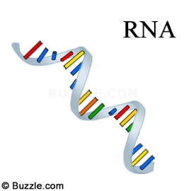
Ribonucleic acid (RNA)
Ribose sugar
A G C U bases
Primary structure - single strand
Can exist secondary and tertiary structures
Three main classes
mRNA, rRNA, tRNA

Slide 21
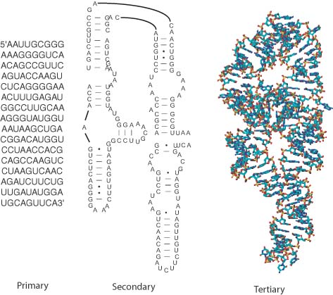
Primary:
Covalent bonds
Secondary/Tertiary
Non-covalent bonds
  H-bonds
  (base-pairing)
  Base stacking

Slide 22
Nucleotide Function
  Energetic Intermediates
  Adenine Enzyme Cofactors
  Regulatory Molecules

Slide 23
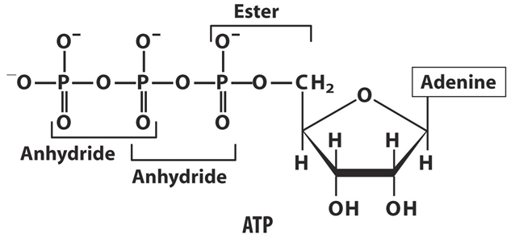
Phospho-Anhydrides and Phosphate Esters - High Energy Bonds

Slide 24
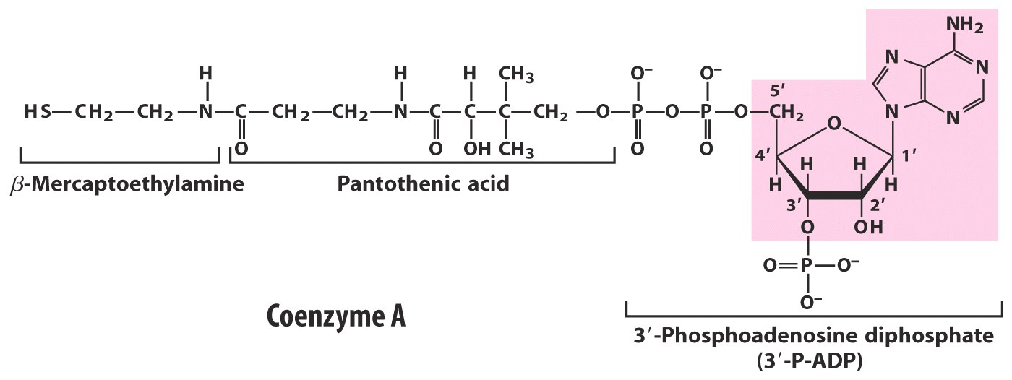
Co-Enzyme A – Carrier for Acetyl units in intermediary metabolism, fatty acid synthesis and oxidation

Slide 25
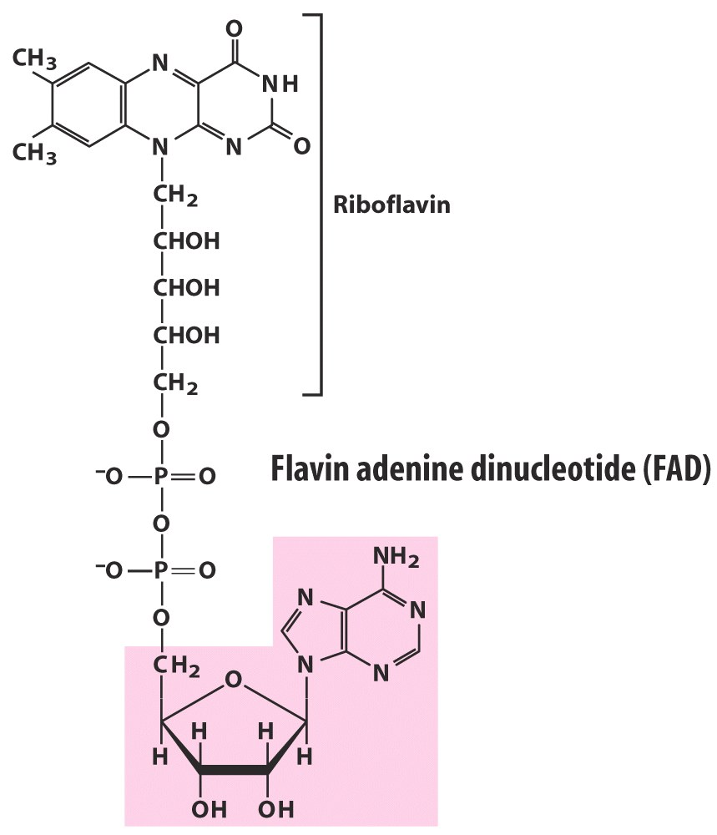
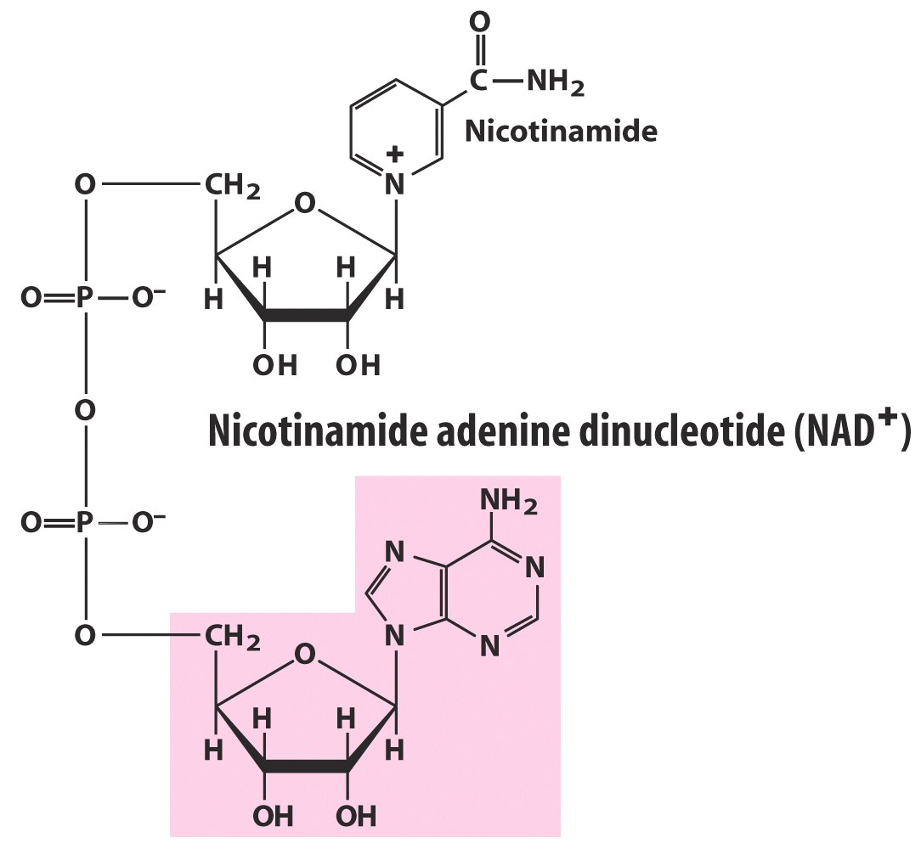
NAD⁺/NADH, NADP⁺/NADPH and FAD/FADH₂
Redox Cofactors

Slide 26
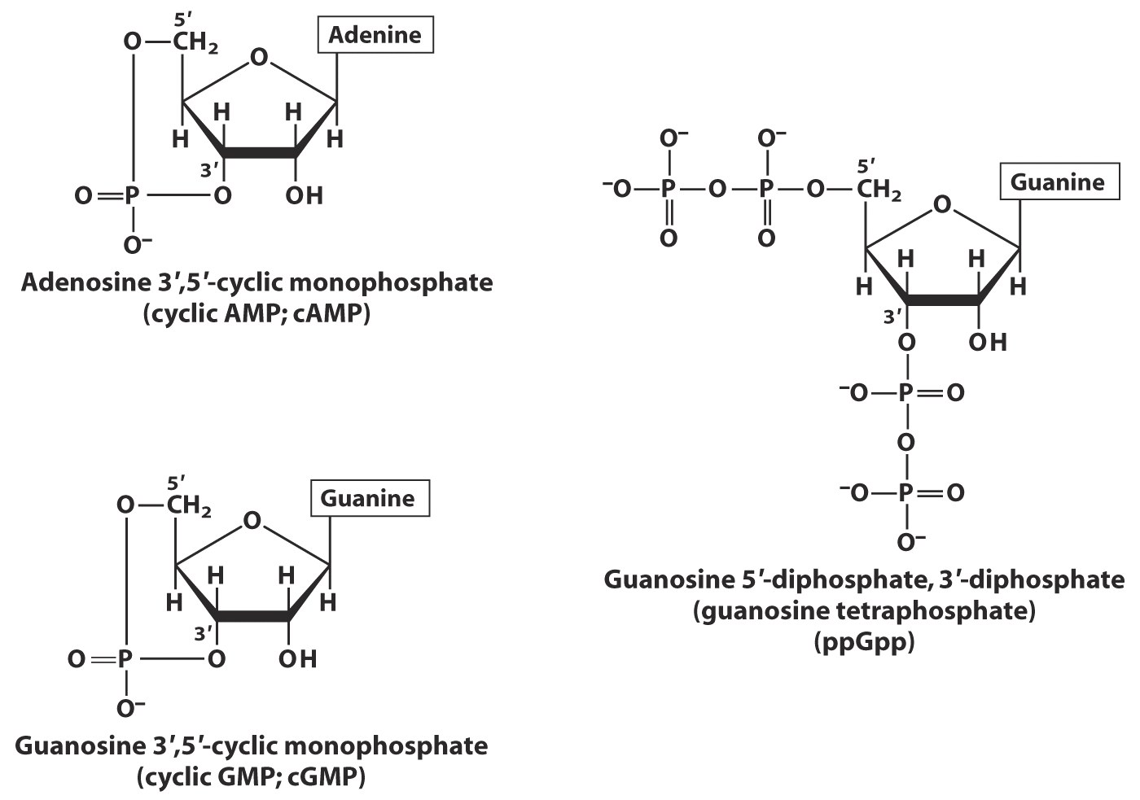
Regulatory/Signaling Molecules

Slide 27


